Slide 1
Audio Sentiment Analysis
Group 3
Feven Kiflai
Sindhu Kumari
Qijun Zheng
Carey Nyein
Htain Lin Shwe

Slide 2
Audio sentiment analysis involves analyzing the emotional tone or sentiment conveyed in an audio recording, like speech or music. It uses computational methods and algorithms to automatically detect and classify the sentiment expressed in the audio.
We aim to examine the emotional tone of the audio we capture for our project. Our goal is to determine whether the tone is positive, negative, or neutral.

Slide 3
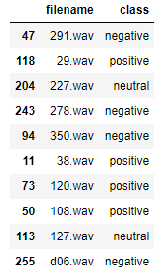
Datasets
You can access the dataset we utilized for our project by following this download link
https://www.kaggle.com/datasets/imsparsh/audio-speech-sentiment?resource=download

Slide 4
Real world problem
Where we can use

Slide 5
Phone Call Support for Customers
Audio Sentiment Analysis can be used for customer support to analyze the behavior and emotions of both support personnel and customers during interactions. This analysis helps identify areas for improvement in customer service.

Slide 6
Example
During customer support phone calls, the tone of the conversation can vary from negative to positive, neutral to positive, positive to neutral, and so on.

Slide 7
2. Related Works

Slide 8
Inspiration from Gender Classification
Neural Network Structure: A Fully Connected Network comprising multiple dense layers
Class Categories: Binary Classification with 2 classes
Source: For more information, please refer to the following resource: "Gender Recognition by Voice using TensorFlow in Python" available at: https://www.thepythoncode.com/article/gender-recognition-by-voice-using-tensorflow-in-python

Slide 9
Guidelines for Audio Data Analysis with TensorFlow
Audio Preprocessing: Preparing the audio data for analysis.
Spectrogram Conversion: Converting waveforms into spectrograms.
Model Training: Training the model using the prepared audio data.
Evaluation and Testing: Assessing the model's performance using separate labeled data.

Slide 10
3. How we solve

Slide 11
The steps of machine learning
Audio preprocessing: Prepare the audio data for analysis.
Feature extraction: After preprocessing, we extract important characteristics from the audio. These characteristics can include things like the pitch of the sound, its tone, how loud or soft it is, the rhythm it follows, and the tempo or speed at which it is played.
Model training: Train a model to classify the sentiment using labeled data.
Evaluation and testing: Assess the model's performance using separate labeled data.

Slide 12
The steps of the whole project
Theoretical analysis
Determine the model according to the characteristics of the data,
Import data to train the model
Adjust the model according to the correct rate
Build a data visualization project, import data through the traditional web structure, and the server analyzes the data according to the model, and displays the data on the mobile phone
According to the data analysis results, make a summary, combine the first step, refer to relevant papers, and make a project report

Slide 13
4. Feature Extraction

Slide 14
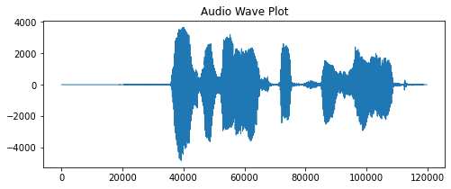
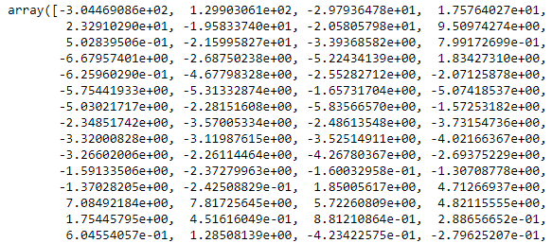
Feature Extraction
MFCC (Mel Frequency Cepstral Coefficients) is commonly used for audio feature extraction due to its effectiveness in representing the spectral characteristics of human speech and other audio signals.

Slide 15
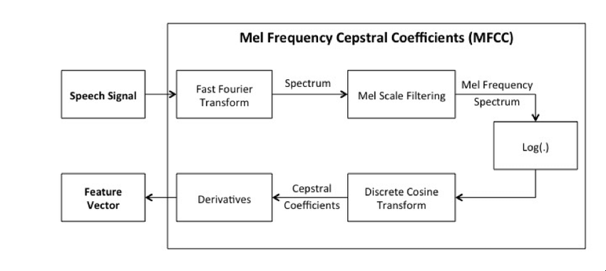
Block diagram of MFCC

Slide 16
Librosa
One popular python library for calculating MFCC is librosa.
Librosa is a widely used audio processing library that provides various functionalities for audio analysis, including feature extraction like MFCCs.

Slide 17
5. Algorithms

Slide 18
BiLSTM (Bidirectional Long Short-Term Memory)
Sequential data analysis: BiLSTM is a neural network architecture designed for analyzing sequential data, such as text or time series.
Bidirectional processing: It consists of two LSTM layers - one processing the sequence in the forward direction and the other in the backward direction.
Capturing context: By processing the sequence in both directions, BiLSTM captures contextual information from both preceding and succeeding elements.
Enhanced understanding: This bidirectional approach enables the model to better understand dependencies and patterns in the sequence.
Applications: BiLSTM has been successfully used in various tasks, including sentiment analysis, named entity recognition, and speech recognition, where understanding the entire sequence is crucial.

Slide 19
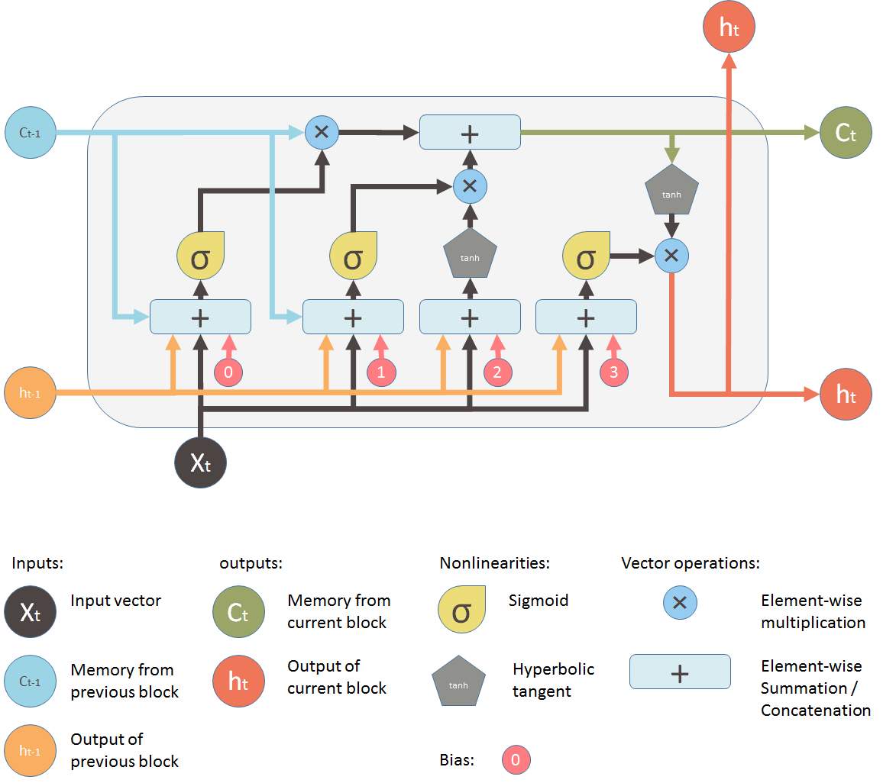
LSTM

Slide 20
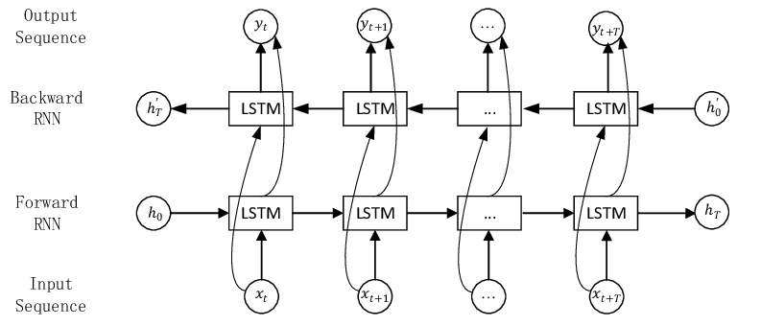
BiLSTM

Slide 21

Why BiLSTM And Not LSTM
We have limited amount of data so we need to used more complicated network.

Slide 22
Why BiLSTM And Not LSTM
BiDirectional: Ability to capture both past and future context
Contextual understanding: BiLSTM captures both past and future context, allowing it to better understand the dependencies and patterns in audio data.
Enhanced feature representation: BiLSTM can effectively represent complex patterns and long-term dependencies in the audio, improving the model's ability to capture nuanced sentiment expressions.
Holistic sentiment inference: Audio sentiment analysis requires considering the entire sequence to understand emotional context. BiLSTM's bidirectional nature helps capture intonations, variations, and emotional cues, leading to more accurate sentiment inference.
Performance advantage: Empirical studies show that BiLSTM often outperforms unidirectional LSTM models in various natural language processing tasks, indicating its potential for improved performance in audio sentiment analysis.

Slide 23
How do we get more data?
Data augmentation (changing pitch, speed, …)
Collect more data
But even if we can manage to do that we still have to analyse the result and of course the augmented data won’t help the model learn that much.

Slide 24
Why Not CNN for Audio Sentiment Analysis
Common approach: CNN (Convolutional Neural Network) has been widely used for audio analysis tasks, including sentiment analysis, by many developers.
Exploring new approaches: Instead of following the common path, we want to explore alternative methods to gain fresh insights and potentially improve results.
Direct audio processing: Instead of converting audio to a spectrogram (a visual representation of audio), we aim to process audio directly. This approach may preserve fine-grained audio details that could be lost during spectrogram conversion.
Accuracy range: By using the proposed method, we have achieved accuracy levels ranging from 60% to 85%. While this range may vary depending on the dataset and other factors, it demonstrates the potential of our approach.

Slide 25
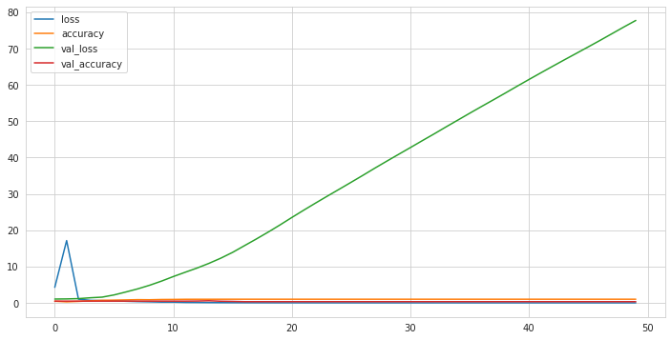
CNN 2D

Slide 26
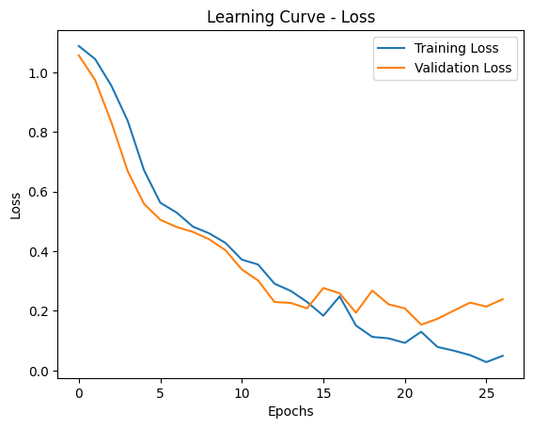
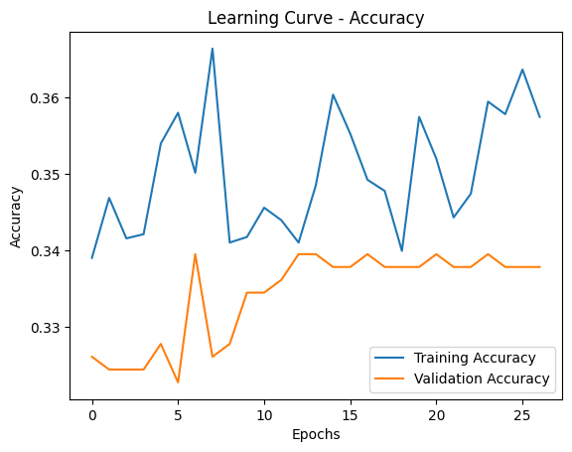
(Long Short-Term Memory) LSTM

Slide 27
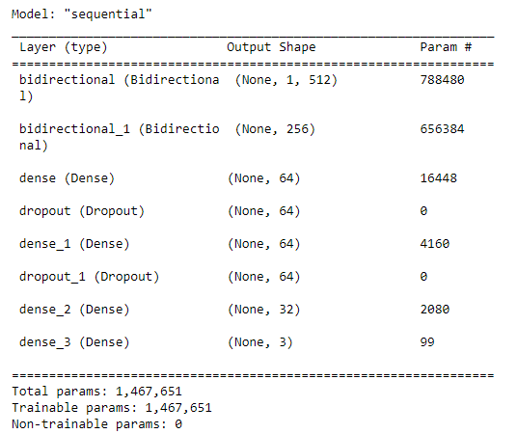

Bidirectional LSTM (Our Model)
Loss Function: Sparse Categorical Cross Entropy
Metrics: Accuracy
Optimizer: Root Mean Square Propagation (Combining averaging over mini-batches, efficiency, and the gradients over successive mini-batches, RMSProp can reach the faster convergence rate than the original optimizer)

Slide 28
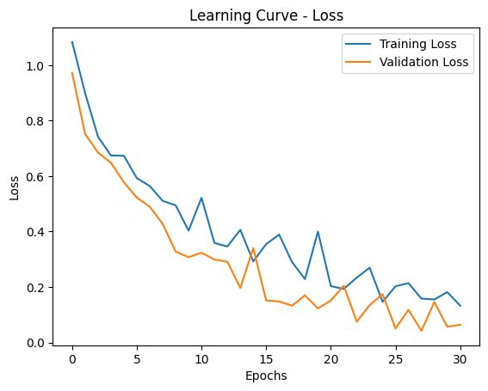
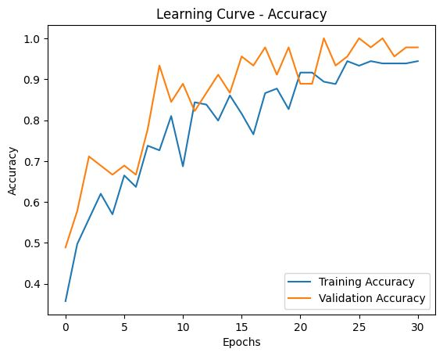
Bidirectional LSTM (Our Model)

Slide 29
6. Demo App

Slide 30
System Flow
Mobile App (Record)
Python Flask Backend
Convert Audio Format
Feature Extract
Predict with Tensorflow Model

Slide 31
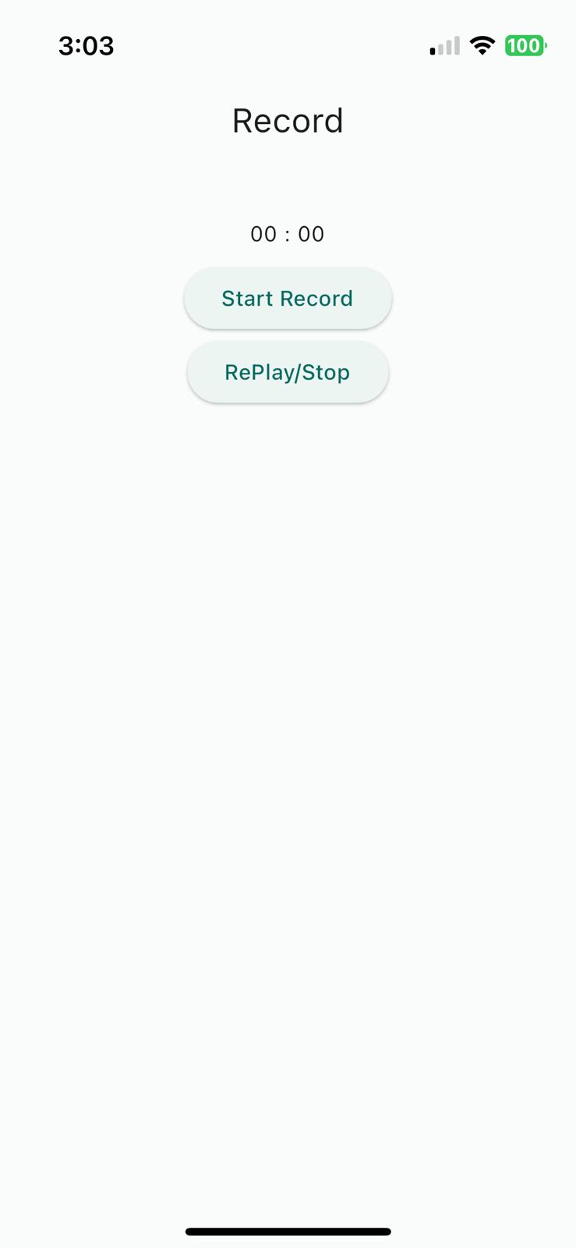
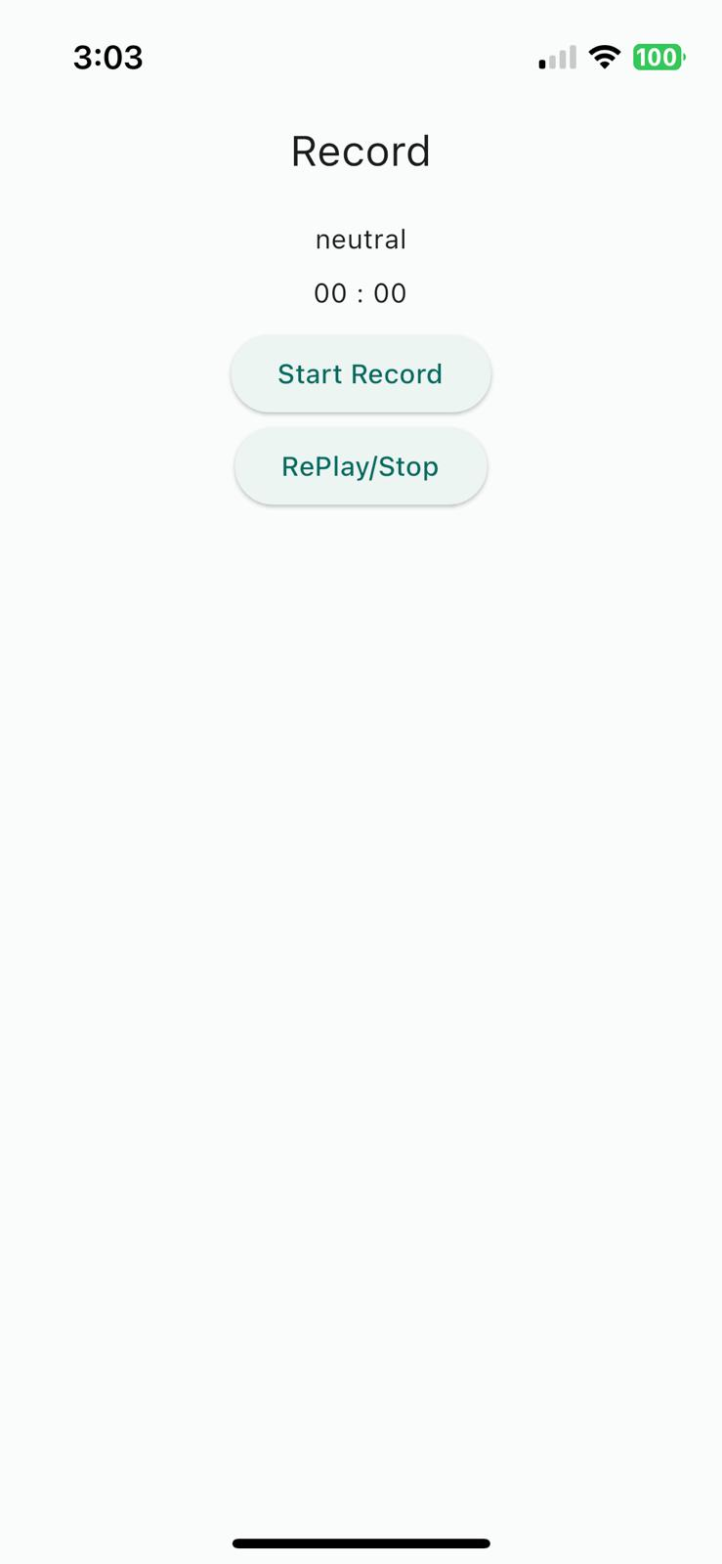

Slide 32
7. Current Issues &
Future Improvement

Slide 33
Current issues
Accent Issue
Need more data to address accent-related challenges.
Improving communication and understanding in multicultural environments.

Slide 34
Current issues
Noisy Reduction
Developing advanced algorithms and techniques to reduce noise in various domains.
Enhancing audio technologies to remove unwanted noise.
Improving signal-to-noise ratio for better quality and clarity.

Slide 35
Future Improvement
Speech Analysis and Recognition
Determining gender (male/female) from speech signals.
Extracting more nuanced emotion information from speech.
Advancing speech recognition systems for accurate identification of individuals.

Slide 36
Future Improvement
Adding More Data
Collecting and incorporating a larger and more diverse dataset.
Expanding the range of accents, languages, and speech patterns.
Collaborating with communities and organizations for representative data

Slide 37
8. Reference

Slide 38
Reference
https://ceur-ws.org/Vol-2328/3_2_paper_17.pdf
https://ieeexplore.ieee.org/abstract/document/6376622
https://arxiv.org/ftp/arxiv/papers/1802/1802.06209.pdf
https://www.hindawi.com/journals/wcmc/2022/4444388/

Slide 39
Thank You
By Group 3

